Slide 1
Chapter 5 Control Flow Commands
5.1- Conditional Execution: The if statement 5.2- Logical expression 5.3- for loop
5.4- while loop
5.5 – Algorithms and assignments

Slide 2
5.1- Conditional Execution: The if statement
If …end If …else ….end If …else if ….else….end
Simple syntax
if <logical expression>
<statement block>
end
if <logical expression>
<statement block1>
else
<statement block2>
end
if <logical expression>
<statement block1>
else if <logical expression>
<statement block2>
else
<statement block3>
end

Slide 3
The if statement tells the computer to execute a block of commands if a specified condition is true.
Simple syntax
if <logical expression>
<statement block>
end
% testFuel.m
% demo if statement with fuel level example
fuelLevel=0.2; % gallons
lowFuelLevel=1.1; % gallons
if (fuelLevel<lowFuelLevel)
disp('Warning--low fuel!');
end
top= 100; MAXIMUM= 10
if (top >= MAXIMUM)
top = 0;
disp(num2str(top));
end

Slide 4
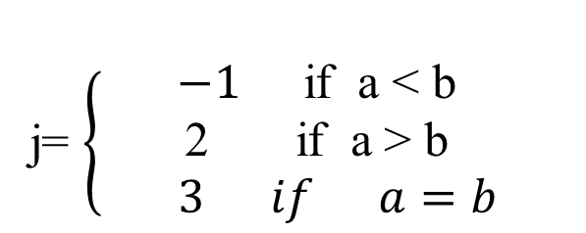
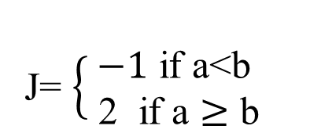
if <logical expression>
<statement block1>
else if <<logical expression>
<statement block2>
else
<statement block3>
end
if <logical expression>
<statement block1>
else
<statement block2>
end
More statements
More conditions
a = 4; b = 3;
if (a<b)
j = -1;
else
j = 2;
end
a = 4; b = 4;
if (a<b)
j = -1;
else if (a>b)
j = 2;
else
j = 3
end
J= $\left\{\begin{aligned}−1 \text{if} \text{a}\text{<}\text{b} \\ \text{ 2 } \text{if} \text{a}≥\text{b}\end{aligned}\right.$
j= $\left\{\begin{aligned}−1 \text{if} \text{a} \text{<} \text{b} \\ \text{2 } \text{if} \text{a}\text{ > }\text{b} \\ 3 if a=b \end{aligned}\right.$

Slide 5
Logical Expressions
Logical expressions are constructed using logical and relational operators.
if (x>=0) && (x<=10)
disp(‘x is in range [0,10]’)
else
disp(‘x is out of range’)
end
&& and
|| or
~ not
== is equal to
~= is not equal to
> is greater than
< is less than
>= is greater than or equal to
<= is less than or equal to

Slide 6
Logical Expressions
Logical expressions evaluate to a value of true or false.
a<5 a is less than 5
(a>0)&&(a<=100) a is greater than 0 and a is less
than or equal to 100
(year>1900)&&(year ~= 1960) year is greater than 1900 and
not equal to 1960
(Tc>Tmin) || (alpha>alphaMax) Tc is greater than Tmin or alpha is
greater than alphaMax

Slide 7
Example: Write a program to input 2 numbers and display whether the first input is greater, less or equal compared with to the second number.
% compare two numbers
num1= input('first number: ');
num2= input('first number');
if (num1 > num2)
disp([ num2str(num1) , ' > ' , num2str(num2)]);
elseif (num1 < num2)
disp([ num2str(num1) , ' < ' , num2str(num2)]);
else
disp([ num2str(num1) , ' = ' , num2str(num2)]);
end

Slide 8
What does this program tell?
clear month = input('Give month number (1-12): ' ); if (month==1 || month==3 || month ==5 || month==7 ||…
month==12 ||month==10 || month==12)
disp('Your month has 31 days‘)
elseif (month==2)
disp('Your month has 28 days‘) else
disp(‘Your month has 30 days’)
end

Slide 9
FOR loops Repeating a block of commands a certain number of times.
Syntax:
for <indexvar>=<initial value>:<increment>:<limiting value>
<command block>
end

Slide 10
FOR loops Repeating a block of commands a certain number of times.
for icount=1:5
disp(['Count is: ',num2str(icount)]);
end
equivalent to:
disp(['Count is: ',num2str(1)]);
disp(['Count is: ',num2str(2)]);
disp(['Count is: ',num2str(3)]);
disp(['Count is: ',num2str(4)]);
disp(['Count is: ',num2str(5)]);
“loop unrolling”
“loop rolling”

Slide 11
x=[1,2,3,4,5,6]
for k=2:4
y(k)=x(k+1)-2*x(k)+x(k-1)
end
y(2)=x(3)-2*x(2)+x(1);
y(3)=x(4)-2*x(3)+x(2);
y(4)=x(5)-2*x(4)+x(3);
unroll the loop

Slide 12
1- Use proper command loop to calculate the following series when N=10 ;
2-
Max and min values between list of 10 values.

Slide 13
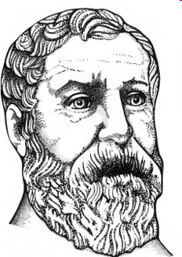
3- useful for loop example
Heron's method for calculating square roots
problem: Find sqrt(n)
Algorithm:
Make a guess at the solution. (x₁)
x₂ = (x₁ + (n / x₁)) / 2
Repeat for x_{3,} x_{4,} x_{5, ...}
Write a matlab program that implements Heron's method to find the square root of 133,579 using 20 iterations of the algorithm.

Slide 14
fprint
to print variables and expression in one statement
fprintf ( ‘ formatSpec ‘A1, A2, ..., An)
Format specifier: %f, %s, %c, %x, %X, %o, %d, %i, …
refer to help fprint to see more ….
Example
a =[89 ,87 , 99];
b=[‘Sam' ; ‘Nan‘ ; ‘Dan‘ ]
for i=1:3
fprintf(‘%s %d \n',b(i,:) , a(i));
end
Output:
Sam 89
Nan 87
Dan 99

Slide 15
Nested loop
for i = 1:6
for j = 1:3
fprintf (‘ *‘ )
end
fprintf('\n')
end
Output
i=1, 2 ,3 ,4 ,5,6
***
***
***
***
***
***
*
**
***
****
*****
******

Slide 16
Conditional loop: while statement
Simple syntax
while <logical expression>
<statement block>
end
If <logical expression> evaluates to TRUE, <statement block> is executed.
Then <logical expression> is evaluated again, and if it remains true,
<statement block> is executed again.
This is repeated until <logical expression> evaluates to FALSE.
Example

Slide 17
while statement
Example
Output:
1 2
3 3
6 4
10 5
sum=0;
maxsum=10;
k=1;
while sum<maxsum
sum=sum+k;
k=k+1;
fprintf('%d % d \n',sum, k);
end
Notes:
CODE: whileDemo.m

Slide 18
while loop equivalent of for loop
while loop
for loop
initialization
k=1;
while k<=10
disp(k);
k=k+1;
end
for k=1:10
disp(k)
end
increment
You are responsible for incrementing while loop so that the condition finally becomes false.
Advantage of while loop: condition and increment are flexible.

Slide 19
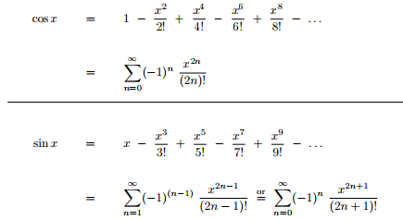
Assignment
Q1- Write algorithm and program code for:
1- factorial n
2- sin(x)
3- GCD (a, b) and LCD(a, b)
note:
LCD (a,b)= a*b/GCD(a,b)

Slide 20
Q1 – What are the outputs of the following programs:
Y=2;x=1 while (x < 5) fprintf('%2.1f %2.1f\n', x, y); y =y*2; x=x+1; end | for i = 1:4 for j = 1:i fprintf('%d %d\n',i ,j); end fprintf('*******\n ') end | for i = 1:4 for j = 1:2*i fprintf('%d %d\n',i j); end fprintf('*******\n ') end | limit = 0.8; s = 0; k=0 while 1 tmp = rand; if tmp > limit break end k=k+1; s= s + t fprintf('%d %d %d\n',tmp ,s , k ); end

